Slide 1
Healthy Workplaces for All Ages
Promoting a sustainable working life

Slide 2
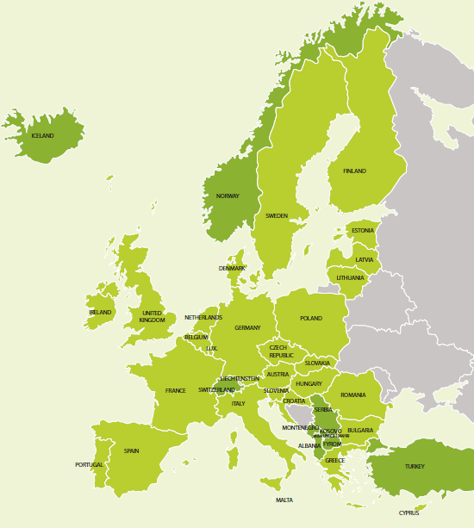
Introduction to the campaign
Coordinated by the European Agency for Safety and Health at Work (EU-OSHA)
Organised in more than 30 countries
Supported by a network of partners:
National focal points
Official campaign partners
European social partners
Media partners
Enterprise Europe Network
EU institutions
Other EU agencies

Slide 3
Key objectives
Promote sustainable work and healthy ageing from the beginning of working life
Highlight the importance of prevention throughout working life
Assist employers and workers (including in SMEs) by providing information and tools for managing OSH in the context of an ageing workforce
Facilitate information exchange and good practice

Slide 4
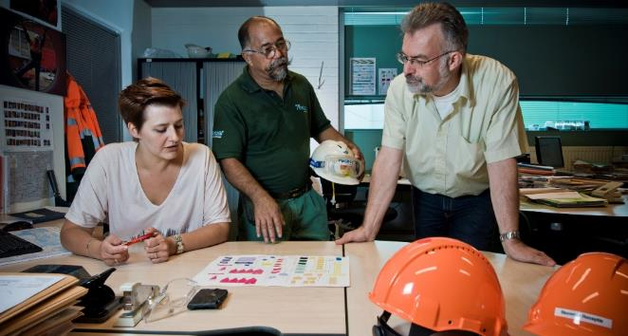
What is the issue?
Europe’s workforce is ageing — longer working lives
Challenges arising from demographic change:
general labour shortages
shortages of skilled workers
more people at work with health problems/chronic diseases
concerns about productivity and absenteeism
Management of OSH in the context of an ageing workforce requires a multidisciplinary approach...

Slide 5
Prevention throughout working life — holistic approach
Health in later life is affected by working conditions in earlier life
Prevention of work-related accidents, health problems and occupational diseases is needed throughout working life
Holistic approach, including:
work environment and organisation
training and lifelong learning
leadership
work–life balance
motivation
career development

Slide 6
Work ability concept
Work ability concept — balance between work demands and individual resources
Work demands affected by:
work content, workload, work organisation
working environment and community
leadership
Individual resources dependent on:
health and functional capacities
skills and competences
values, attitudes, motivation
Promoting work ability requires:
good leadership
worker participation
cooperation between management and workers
Work ability index

Slide 7
Diversity-sensitive risk assessment
Risk assessment is the cornerstone of OSH management in Europe
Differences exist between individuals, take account of:
age
gender
disability
migrants
For younger workers, take account of:
physical and intellectual development
immaturity
lack of experience
For older workers, consider:
high-risk situations (e.g. shift work, high physical workload, extreme temperatures)
Older workers are not a homogeneous group and differences in both functional capacity and health between individuals increase with age
Diversity addressed by focusing on work demands in relation to individual capacities and health

Slide 8
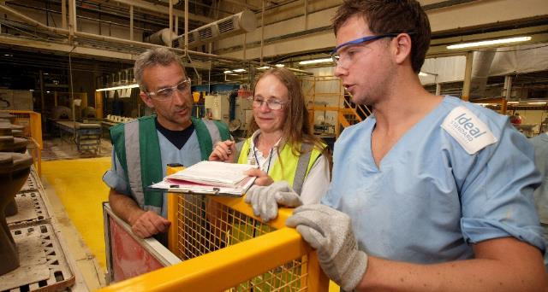
Adapting the workplace
Work should be adapted to individual abilities, skills and health status, as well as other factors of diversity
Dynamic and continuous process throughout working life
Examples of changes in response to functional capacity:
use of equipment
good ergonomic design
job re-design
job rotation
Good workplace design and good organisation benefit all ages

Slide 9
Disability prevention, rehabilitation and return to work
Work is good for health provided that working conditions are decent
Long-term sick leave can lead to mental health issues
Health issues most common reason for leaving workforce early
Important to help people with health problems remain in work through rehabilitation and return to work
Good examples:
‘sick note’ replaced by ‘fit note’ — UK
‘return to work’ intervention project — Denmark
‘fit2work’ programme — Austria

Slide 10
Lifelong learning
Enable workers of all ages to take part in education and training
Prevent erosion of skills and competences
Updating and developing skills important for employability
Also important for psychosocial working environment

Slide 11
Workplace health promotion
Combined efforts of employers, employees and society to improve health and well-being at work
Can be only successful if combined with risk prevention and health protection
‘Health promoting workplaces’ – a comprehensive approach, integrating OSH and health protection with health promotion, addressing both work organisation and work environment issues and the individual risk factors.

Slide 12
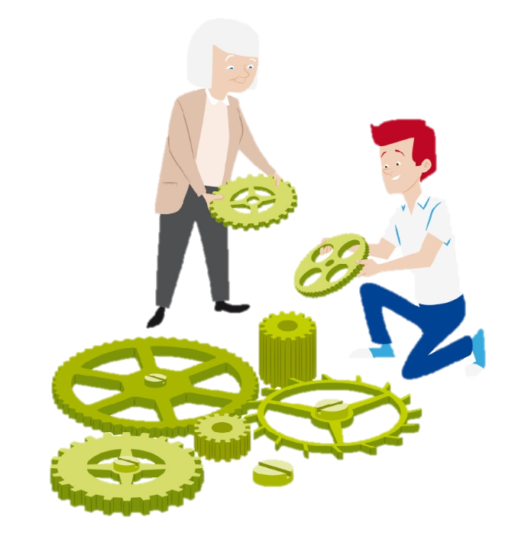
Human resources (HR) and OSH management
Cooperation between stakeholders is very important, particularly HR and OSH management
HR policies have an impact on safety and health, for example:
work–life balance
working time
lifelong learning
career development
HR should support OSH management of all ages

Slide 13
What are the benefits?
Improve health and well-being of employees:
working is good for physical and mental health
health of workers of all ages can be improved
Improve productivity and cost-effectiveness at organisational level:
healthy, productive and motivated workforce — organisation remains competitive and innovative
valuable skills and experience retained within organisation
lower rates of sick leave and absenteeism — lower work disability costs
lower staff turnover
greater well-being at work, with employees achieving their potential

Slide 14
Getting involved
Organisations of all sizes and sectors, as well as individuals, can get involved
Get involved by:
disseminating campaign materials
taking part in or organising events and activities
using and promoting age-management tools
becoming a partner of the campaign
keeping up to date via social media

Slide 15
Key dates
Campaign launch: April 2016
European Weeks for Safety and Health at Work: October 2016 and 2017
Healthy Workplaces Good Practice Awards Ceremony: April 2017
Healthy Workplaces Summit: November 2017

Slide 16
Campaign partnership offer
Successful partnerships between EU-OSHA and key stakeholders are crucial for the success of the campaign
Pan-European and international organisations can become official campaign partners
Benefits include:
a welcome pack
a partner certificate
special category for partners in the Healthy Workplaces Good Practice Awards
promotion at EU level and in the media
networking opportunities and exchange of good practice with other campaign partners
invitation to EU-OSHA events

Slide 17
Healthy Workplaces Good Practice Awards
Recognition of innovative safety and health practices in the workplace
Organisations are rewarded for successful and sustainable initiatives promoting healthy workplaces for all ages
Open to organisations in:
EU Member States
candidate countries
potential candidate countries
European Free Trade Association (EFTA)
Two stages:
National level — focal points nominate national winners
European level — official campaign partners and national winners
Winners announced at the awards ceremony

Slide 18
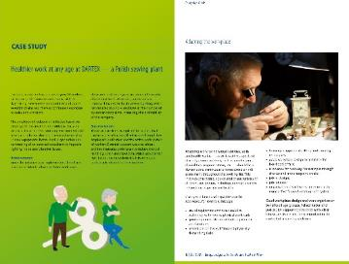
Campaign resources
Campaign guide
Practical e-guide
Promotion material
Campaign leaflet
Good Practice Awards flyer
Poster
Video
Infographics
Online banner, Email signature
Napo film
Materials from ‘Safer and healthier work at any age’ (European Parliament pilot project)
Module for Online interactive Risk Assessment (OiRA)
Reports

Slide 19
Further information
Learn more at the campaign website: www.healthy-workplaces.eu
Subscribe to our campaign newsletter: https://healthy-workplaces.eu/en/healthy-workplaces-newsletter
Keep up to date with activities and events through social media:
Find out about events in your country from your focal point: www.healthy-workplaces.eu/fops

